Slide 1

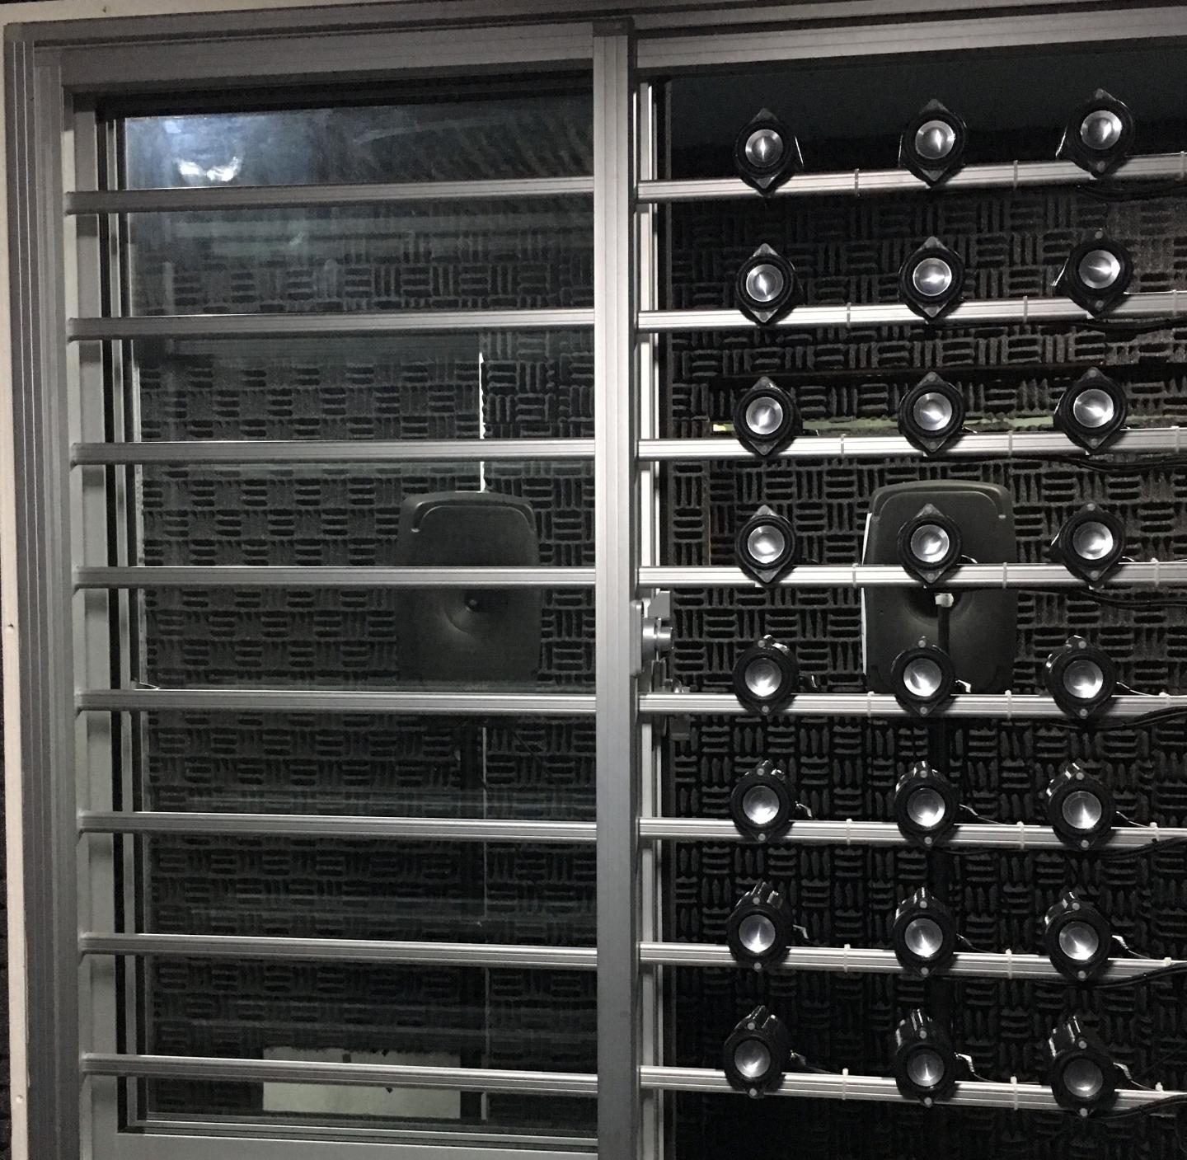


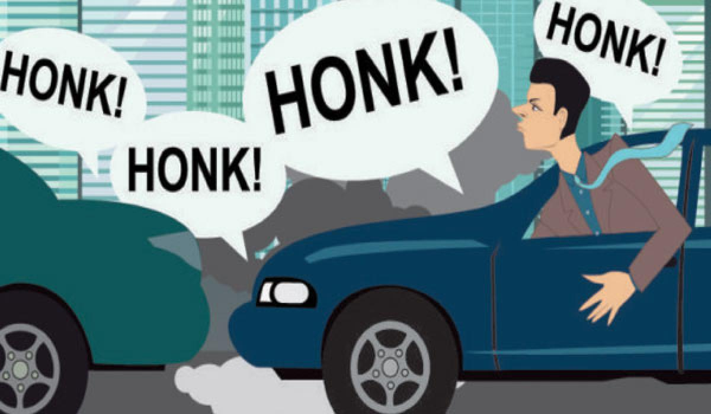
Energy
Management
Noise Reduction in Wari
REDX MITAOE Project
Namrata More
Mayank Chourasia
Bhushan Batule
Nikita Lomte

Slide 2
Outline
Noise Pollution one of the main problem considering the ‘C’, type person, not OK with the “OK fine its normal noise in Wari”
“Reducing noise with sound”
With AI & MATLAB

Slide 3
The Major ProblemS (SPOT)
Uneven Crowdflow
Waste Management
Health Problems
Pollution
Sanitary
Traffic & Parking Problem

Slide 4
Information architecture
WARI
Uneven Crowdflow
Traffic & Parking
Pollution
Health Problems
Waste Segregation
Sanitary
Air Pollution
Water Pollution
Noise Pollution
Soil Pollution

Slide 5
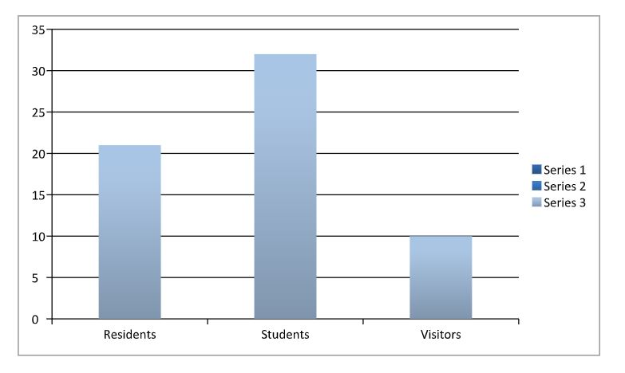
Stake
Holders
01
1
Problem worth solving as a feedback from these stakeholders such as:
Students
Hospitals
Residents, survey till date

Slide 6
What our stakeholders do today ?
No regular colleges
Sleep
Close Windows
Go to their natives
Hospital patients suffer more
Listen to the Bhajans & Kirtans
So basically being ‘A’ or ‘B’ type person

Slide 7
Environment
Analysis
02
82%
Survey says it is an issue worth solving
Horrible effect on health, environment, studies

Slide 8
Energy:
Noise Reflector
Being a ‘C’ type person
The benefits would be: windows can be left open for fresh air without disturbance from external noise pollution, and reducing the need for air-conditioning to keep the interiors of buildings and homes cool.
The device would be using an 'active noise control' technology - found in many high-end headphones that cancels external noise - that is adapted to work in a large open area.
Using MATLAB we can analyse the coming wave and revert back a wave for superimposing using a hardware such as a buzzer.

Slide 9
Working with AI & MATLAB
Considering a window, several units can be placed together to form a grid-like array on a window grille to reduce external noise.
The device uses a special sound emitting mechanism which works like a speaker or buzzer and is hooked up to a processing unit. Equipped with a microphone, it can detect & analyse the noise wave with AI even before it reaches the window and computes the attributes of the incoming noise in real-time (MATLAB).
It would quickly emits a countering sound or "anti-noise" ie. inverted or "flipped" & they cancel each other out, resulting in a softer ambient sound entering living spaces.

Slide 10
Timeline
WEEK 1
WEEK 2
WEEK 3
WEEK 4
WEEK 5
WEEK 6
Introduction to
REDX
Brain storming Problems & group formation
Noise Cancelling Device using sound to remove noise.
Stakeholder Analysis
Literature Survey
Working on code & hardware

Slide 11
References
https://www.eurekalert.org/pub_releases/2018-05/ntu-ncd042618.php
https://www.energylens.com/articles/energy-management
https://en.m.wikipedia.org/wiki/Energy_management

